Slide 1



Title: Implementation of Chatbot using NLP
Developed an AI-powered chatbot that answers basic questions
Uses Natural Language Processing (NLP) techniques
Implements TF-IDF Vectorization and Cosine Similarity for intelligent response selection

Slide 2

Learning Objectives
Understand NLP-based chatbot development
Learn TF-IDF vectorization for text processing
Implement cosine similarity for response selection
Build a chatbot that answers AI, Python, and general queries
GOAL

Slide 3
Goal
To develop an AI-powered chatbot capable of answering basic AI, Python, and general knowledge questions
Create an efficient, lightweight chatbot without relying on external APIs

Slide 4
Tools and Technology used
Python (Programming Language)
NLTK (Natural Language Toolkit for text processing)
Scikit-learn (TF-IDF, Cosine Similarity)
Pandas & NumPy (Data handling)
Command-line interface (User interaction)

Slide 5
Problem Statement:
Traditional chatbots require extensive datasets and complex AI training
Need a chatbot that can learn from predefined questions using simple NLP techniques
Rule-based chatbots lack flexibility in understanding natural language

Slide 6
Solution:
A chatbot that uses TF-IDF vectorization to process user queries
Cosine Similarity helps match user input to the most relevant predefined response
Predefined knowledge base for AI, Python, and general queries

Slide 7
Methodology
Response Selection: Returning the most relevant answer
Preprocessing Text: Lowercasing, removing punctuation, and tokenization
TF-IDF Vectorization: Converting text to numerical form
Cosine Similarity: Measuring how closely user input matches stored questions

Slide 8
Implementation
Implemented using Python and NLTK
Predefined Q&A pairs stored as a knowledge base
Uses TF-IDF vectorizer for feature extraction
Runs in a command-line interface

Slide 9
Features
✔ Answers questions related to AI, Python, and general knowledge ✔ Engages in small talk (Greetings, Jokes, Fun Facts) ✔ Uses NLP techniques for response selection ✔ Lightweight – does not require external APIs

Slide 10
TF-IDF Explanation
TF-IDF (Term Frequency-Inverse Document Frequency) is used to determine the importance of words in a document
Helps the chatbot prioritize important words in a query
Ensures more relevant responses based on keyword importance

Slide 11
Cosine Similarity
Measures how similar two text vectors are
Helps chatbot find the closest matching question in the dataset
Used to select the best response

Slide 12
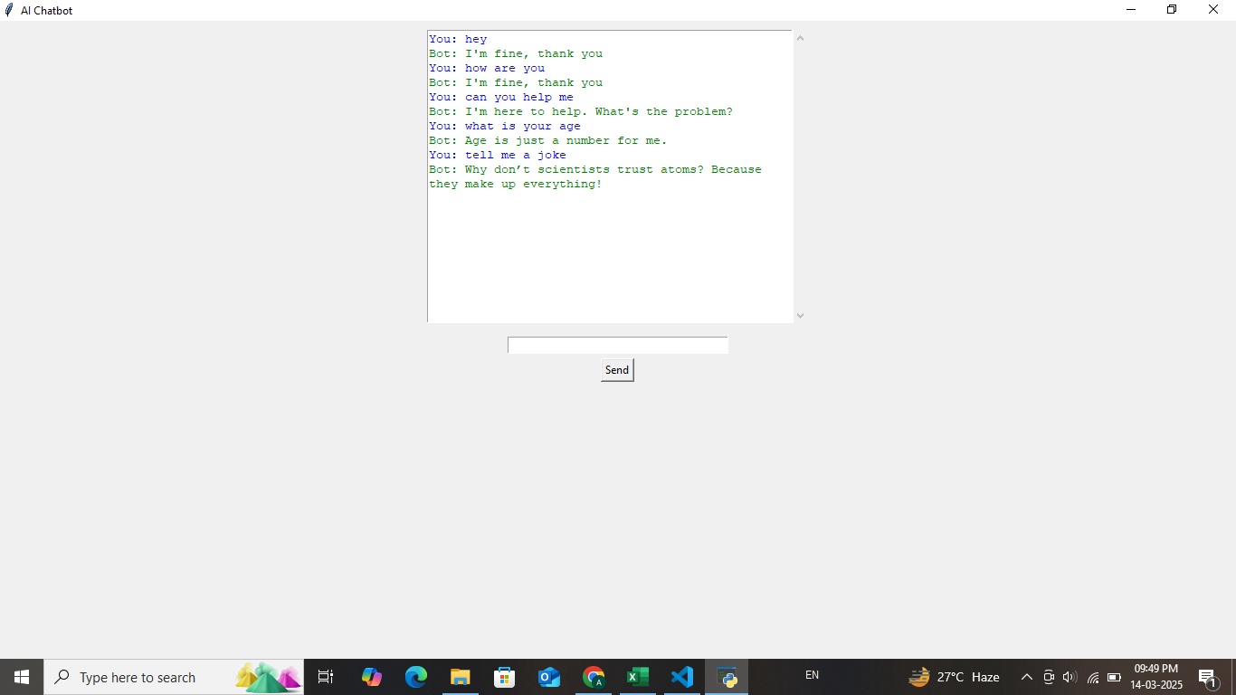
Screenshot of Output:

Slide 13
Future Enhancements
> Integrate GUI with Tkinter or Flask > Expand knowledge base for more topics > Add speech-to-text for voice-based chatbot

Slide 14
Conclusion
Successfully developed a chatbot using NLP, TF-IDF, and Cosine Similarity
Provides answers to AI, Python, and general questions
Future improvements include GUI integration and voice support

